Slide 1
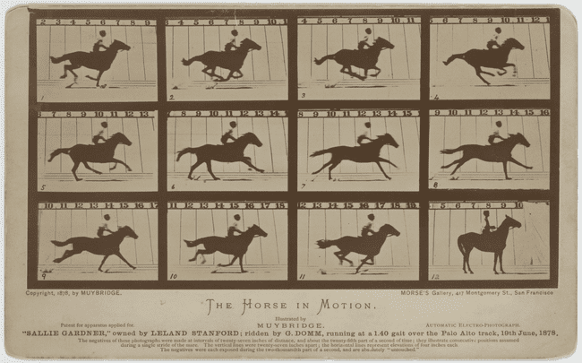

Slide 2
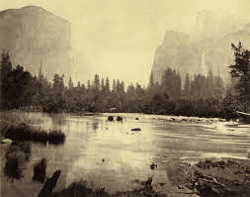
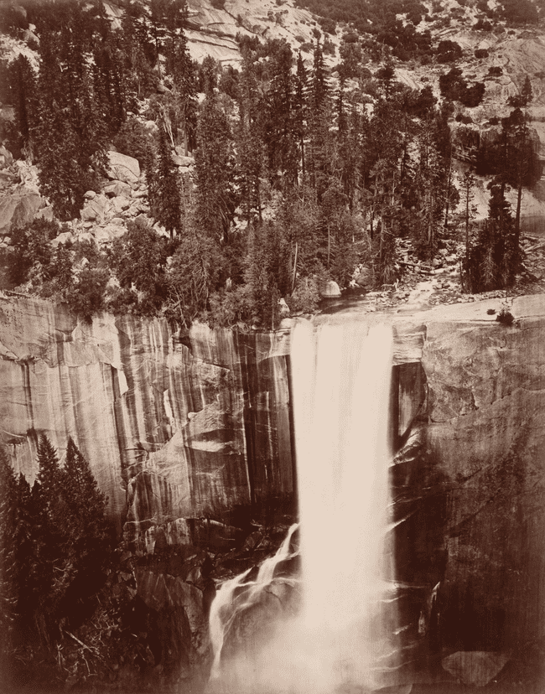
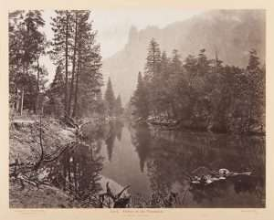
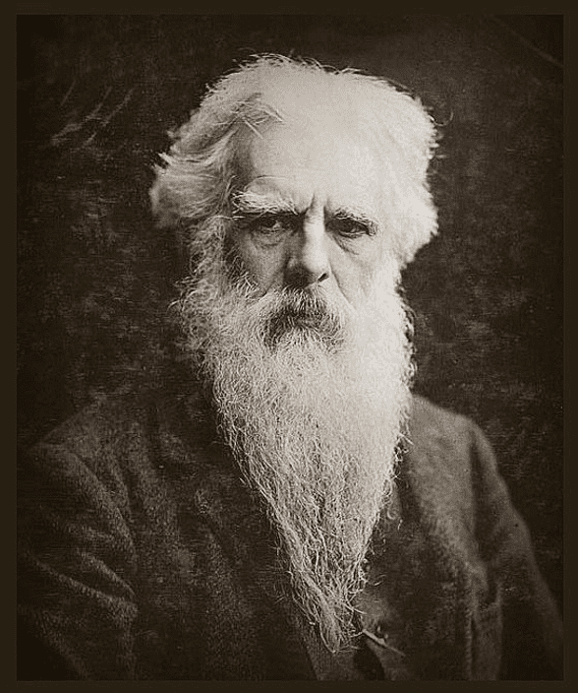
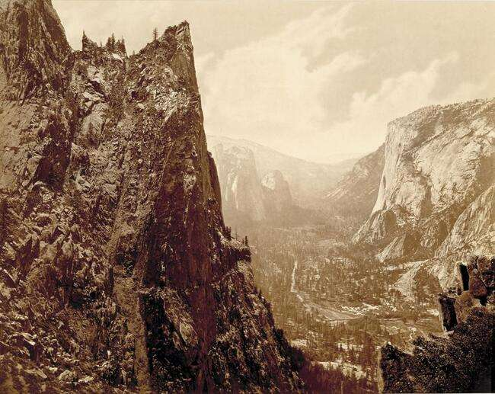
Muybridge began his career making pictures of Yosemite, taking his bulky camera and portable darkroom through the valley’s rough terrain, to the high peaks where he could capture the landscapes.
Eadweard Muybridge

Slide 3
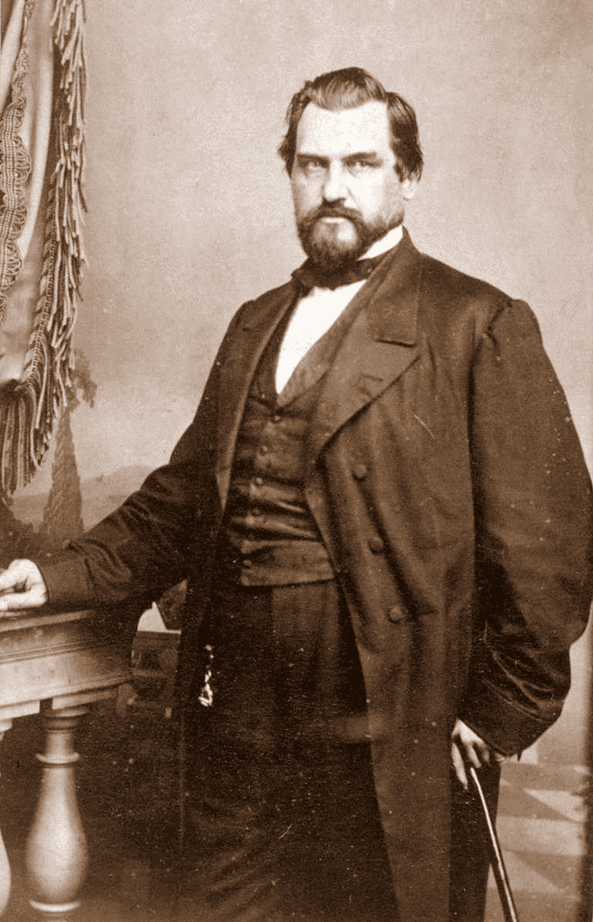
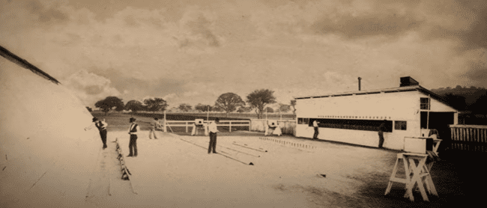
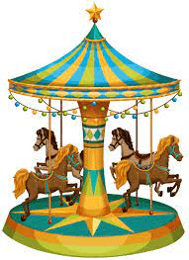
1872 - At this time, a controversy prevailed among experienced horsemen as to whether all the feet of a trotting horse were clear off the ground in the same instant. To settle the debate, the railroad magnate, Leland Stanford, hired Muybridge to photograph his prized racehorse Occident, at a trot.
Leland Stanford
Muybridge constructed a track specifically for the purpose. Multiple cameras were lined up, each connected to a wire stretched across the track.
As the horse hit each wire, a camera was triggered to capture an instant in time.
NOTE: Horses on merry-go-rounds and in academic painting had long been represented with all feet off the ground, stretched out in front and back.

Slide 4
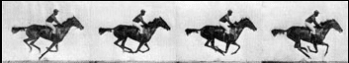
Muybridge’s pictures proved something else, that the feet do leave the ground at once, but when they're under the horse's body.
It was the first time that such rapid motion could be seen like this. Thin slices of time quicker than anything the human eye could perceive. 1880 - Muybridge experimented with the optical gadgets of the time:
Thaumatrope
Zoetrope
Phenakistoscope

Slide 5
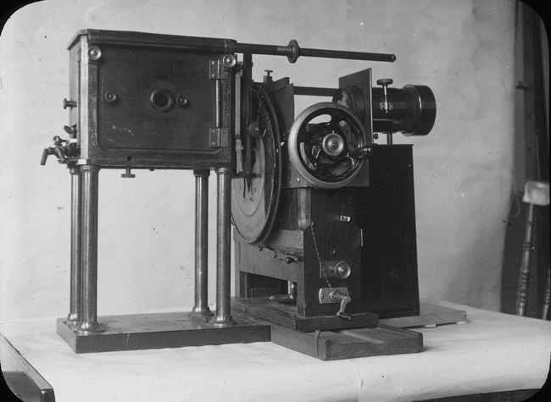
He created something he called the zoopraxiscope, a precursor to cinema. It showed his still images in rapid sequence, reanimating the still photos and cast the image on a wall.
Zoopraxiscope

Slide 6
Some would say that the only thing lacking was the sound of the hooves pounding the ground. Or they would have believed that horses were really running through the room.

Slide 7
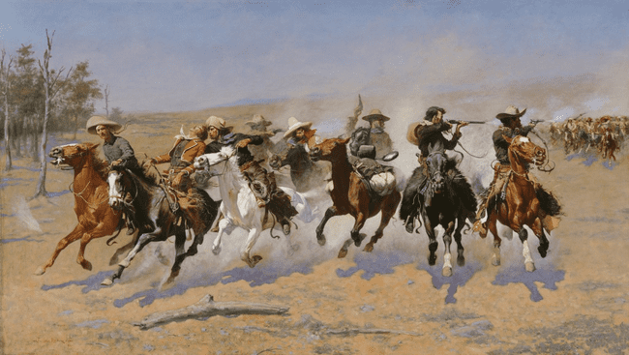
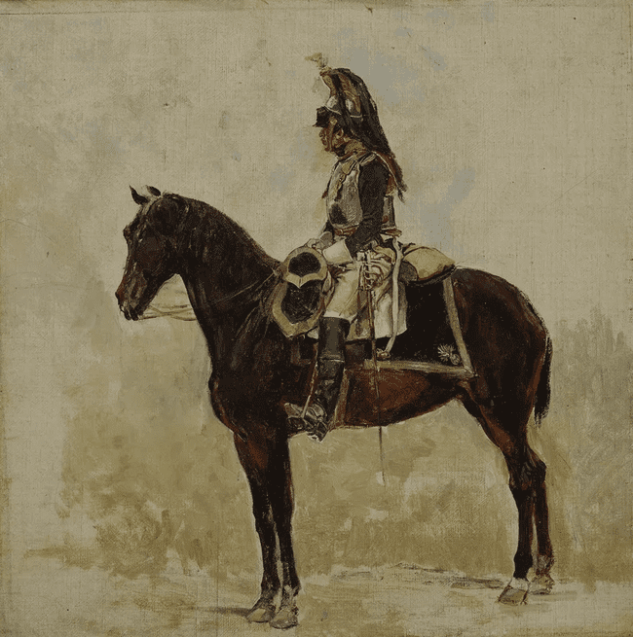
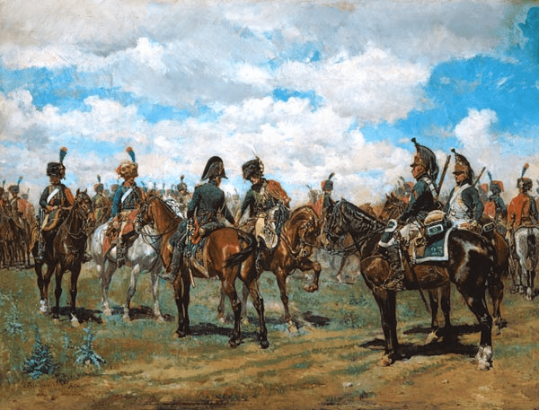
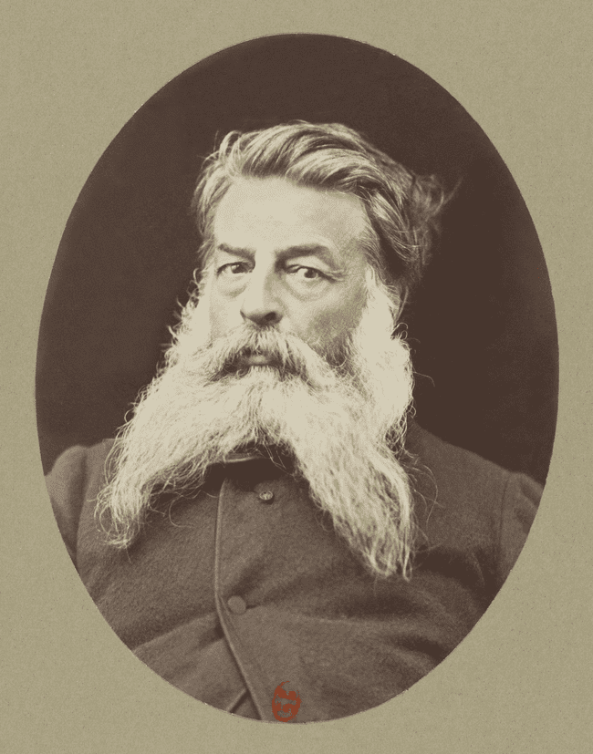
Meissonier, a celebrated painter of horses, is said to have wept when he saw Muybridge's photographs.
Ernest Meissonier

Slide 8
